Slide 1





Belief Decay or Persistence? A Mixed-method Study on Belief Movement Over Time
Shrey Gupta ^{[1]}
Alireza Karduni ^{[2]}
Emily Wall ^{[1]}
[1] Emory University, Atlanta, US
[2] IDEO, Chicago, US
Notes:
Paper Title
I’m Ali
Coauthors are…

Slide 2
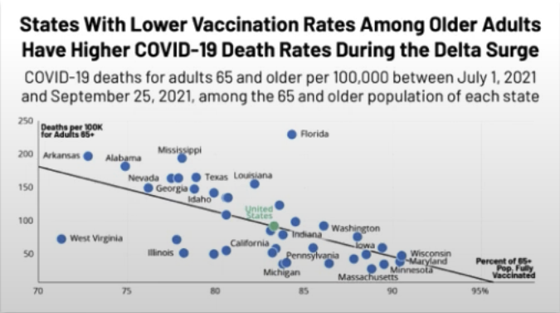
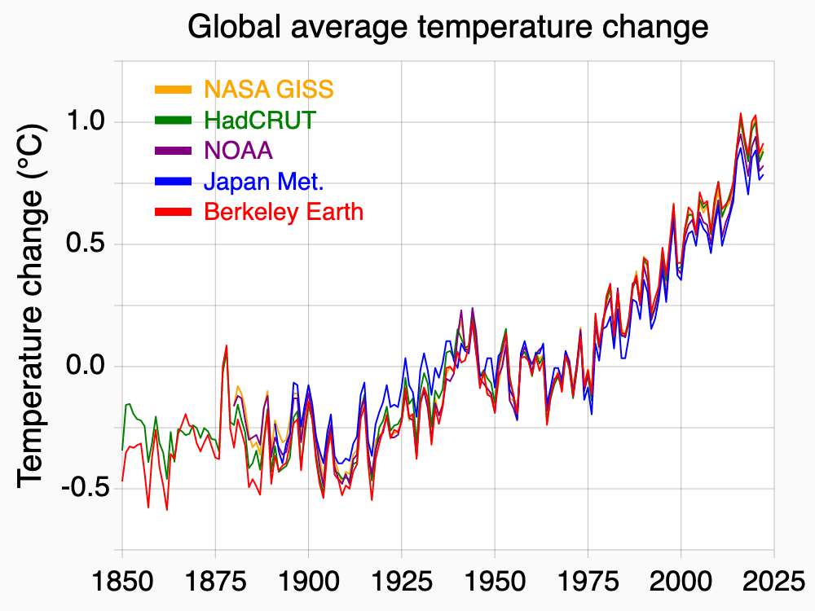
MOTIVATION
Notes:
Data visualizations play a really important role in science communication. And sometimes it’s important that people have a common understanding from

Slide 3
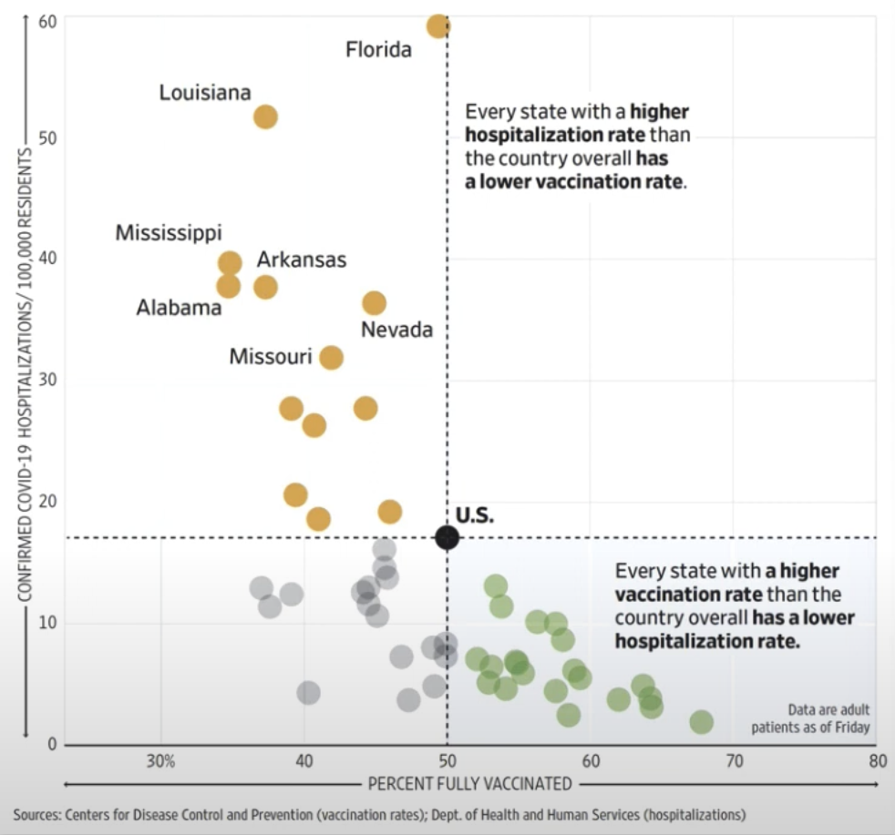
MOTIVATION

Slide 4





Why Study
Belief Change
We are surrounded with information that affects our understanding and beliefs about the world around us.
What makes information persistent and persuasive?
MOTIVATION
Notes:
Original question: Why study belief change with visualizations, why it is important
Script: Our beliefs get affected by various media sources around us in the form of speech, text, social and interactive media.
Surrounded with information
*Speech
*Text
*Social
*and Interactive Media

Slide 5


Belief Update | Capturing the belief change
Change in beliefs when new evidence is presented.
Posterior Beliefs
Individual’s new beliefs after evidence shown.
MOTIVATION
I am pretty sure in this day & age no gender bias exists
Ah, I see, we need to work a lot more to mitigate gender bias.
Evidence shows in most professions women are still paid 77 cents on the dollar compared to men.
Prior Beliefs
Individual’s pre-existing beliefs.
Notes:
As we encounter this new information, we update our beliefs
Afterwards, we call that our “posterior belief”
Example: gender bias
“I’m pretty sure gender bias no longer exists”
I see new evidence in a news article
And update my belief, because I’m a reasonable person who is responsive to new information.

Slide 6
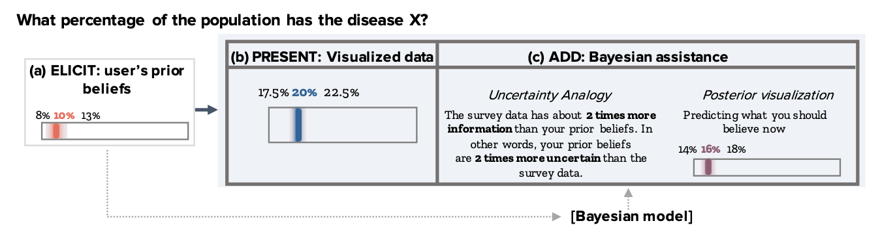
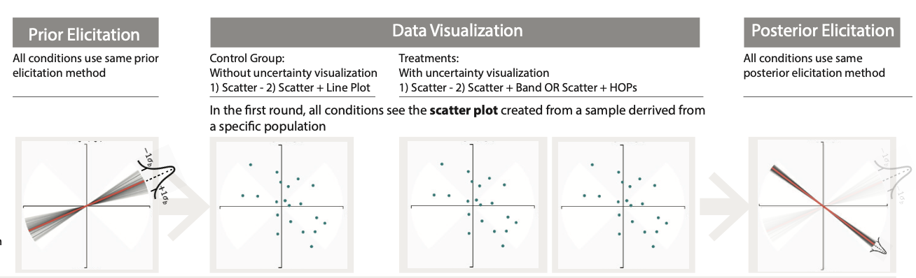
The Belief Update Framework
Previous studies measure “updated” beliefs immediately after new data is shown.
Kim, Yea-Seul, et al. "Bayesian-assisted inference from visualized data." IEEE Transactions on Visualization and Computer Graphics 27.2 (2020): 989-999.
Karduni, Alireza, et al. "A bayesian cognition approach for belief updating of correlation judgement through uncertainty visualizations." IEEE Transactions on Visualization and Computer Graphics 27.2 (2020): 978-988.
BACKGROUND
Notes:
So how can we get systematic about how we are measuring these belief updates?
We can consider a framework for how to measure belief updates
There are lots of studies in the vis community and beyond that look at belief updating – and compare how people update their beliefs to some normative value, typically using a Bayesian framework.
So that’s the technical part.

Slide 7

Belief Update | Effect of Time
When we update our beliefs, do we really retain that information?
What happens after some time passes?
Are our updated beliefs persistent over time?
MOTIVATION
Notes:
We go about our day,
We keep analyzing data,
Etc.
So when we update our beliefs, do we really retain that information?

Slide 8
Belief Decay or Persistence? A Mixed-method Study on Belief Movement Over Time
Shrey Gupta ^{[1]}
Alireza Karduni ^{[2]}
Emily Wall ^{[1]}
[1] Emory University, Atlanta, US
[2] IDEO, Chicago, US
Notes:
Paper Title
I’m Ali
Coauthors are…

Slide 9
“What is the correlation between years of education and income“
🤓

Slide 10
I believe higher education ALWAYS leads to higher income.
Prior belief
Income
🤓
Years of education

Slide 11
Income
🤔
What the data shows
Years of education

Slide 12
Asked again
“What is the correlation between years of education and income“
🤔

Slide 13
I believe higher education sometimes leads to higher income.
Income
🙄
Posterior belief
Years of education

Slide 14
I believe higher education sometimes leads to higher income.
Prior belief
Income
🙄
Posterior belief
What the data shows
Years of education

Slide 15

Asked again
“What is the correlation between years of education and income“

Slide 16
I Still believe higher education sometimes leads to higher income.
Prior belief
Income
🙄
What the data shows
Years of education

Slide 17
I changed my mind, I believe higher education and income are sometimes not associated with each other
Prior belief
Income
🙄
What the data shows
Years of education

Slide 18
I think I was originally right, I believe higher education always leads to higher income.
Prior belief
Income
🙄
What the data shows
Years of education

Slide 19
What happens to the posterior (updated) beliefs over a period of time?
Do the updated beliefs stay the same over a period of time?
Do they change with time?
If they change then what kind of movement is observed?
Notes:
We will explore these questions in our study:
What happens to the posterior (updated) beliefs over a period of time?
Do they stay the same?
Do they change?
If they change, then do they move systematically in some direction?

Slide 20

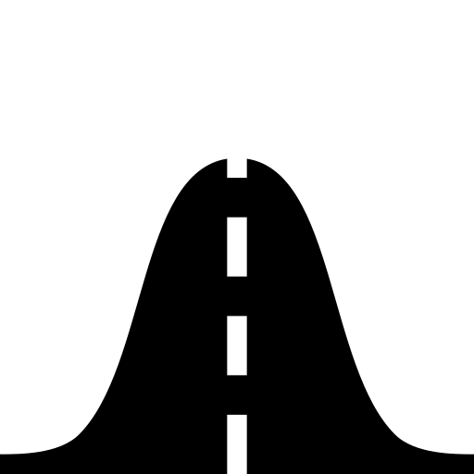

Belief Movement
Change in the direction and magnitude of belief during the belief update process.
Maintenance
No movement observed in posterior beliefs
BACKGROUND
Prior
Posterior (T0)/(T5)
Data
Posterior (T0)/(T5) shows no significant movement
Notes:
Now, that’s the prior belief.
When I show new data, which might be in the form of a scatterplot ** add animation here to show scatterplot **, it’s also a distribution because there’s some uncertainty around these values.
As a reasonable person, I incorporate that new information into my prior beliefs, and I get an updated or posterior belief.
Now… if time passes, I go about my day, I sleep, drink coffee, and take my cat for a walk, and my belief after all that time is still the same, then we will say that I have maintained that belief.

Slide 21
Belief Movement
Change in the direction and magnitude of belief during the belief update process.
Decay
Posterior belief moves towards prior belief
BACKGROUND
Prior
Posterior (T5)
Posterior (T0)
Data
Posterior (T5) moves towards Prior
Notes:
But, if after I’ve slept, walked my cat, and baked donuts, my belief now shifts back toward my prior (maybe I’ve forgotten the data I saw, maybe I didn’t really incorporate it into my beliefs), then we will call that belief decay

Slide 22
Belief Movement
Change in the direction and magnitude of belief during the belief update process.
Strengthening
Posterior belief moves towards data shown
BACKGROUND
Prior
Posterior (T0)
Posterior (T5)
Data
Posterior (T5) moves towards Data shown
Notes:
And finally, if after I’ve slept, baked donuts, and chopped up firewood, my belief shifts more towards the data, then we will call that belief strengthening

Slide 23
HYPOTHESES
We hypothesize that with the passing of time individuals would experience ‘decay’ of their beliefs i.e. forget the data shown (or) resort back to their prior belief
H1: The posterior beliefs would show movement towards prior over time. (Decay)
H2: The amount of belief decay over time will be moderated by the
strength of the prior belief.
Notes:
So given this background here, are our hypotheses:
The posterior beliefs would show movement towards prior over time. (belief decay)
The uncertainty for strongly held prior beliefs would increase over time. (with time, potentially distractions, new information, people will forget)

Slide 24

STUDY DESIGN
Notes:
How did we evaluate these hypotheses?

Slide 25
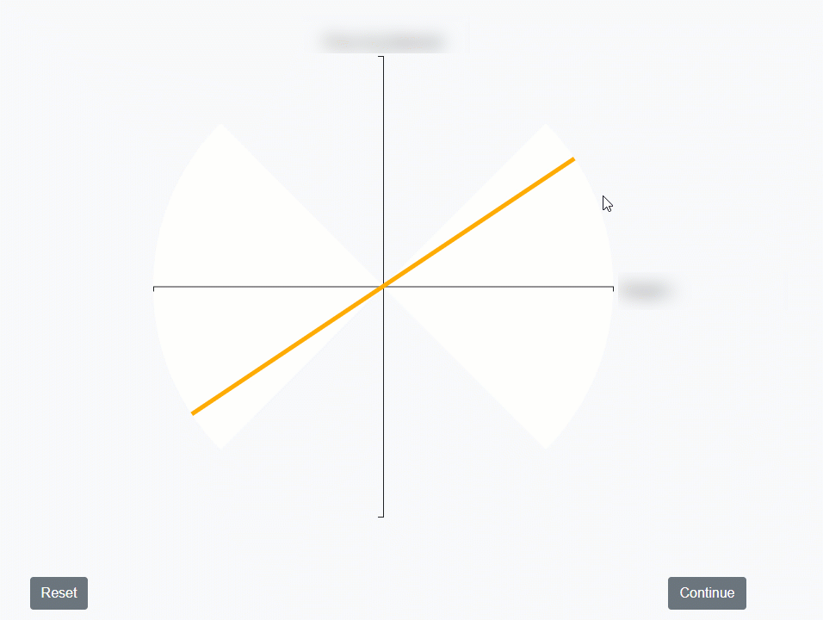
Belief Elicitation
Capturing participant beliefs on a specific subject
Line+Cone
BACKGROUND
Notes:
Script: as visualization researchers, we are particularly interested in how beliefs are affected by visual representations of data. (and show some visualizations)

Slide 26
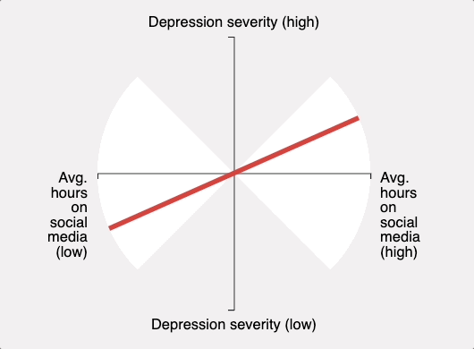
Study Design
STUDY DESIGN
Notes:
First we elicit users prior belief, in this case, about depression sevirity and Avg hours spent on social media.
And this person things they are very positively correlated.

Slide 27
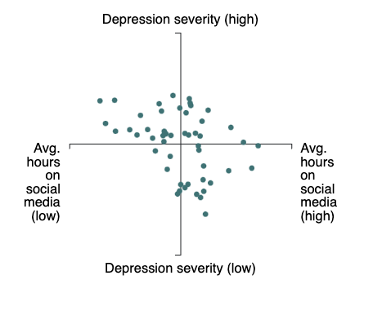
Study Design
STUDY DESIGN
Notes:
First, we had a background survey including
Age
Education level
Etc.

Slide 28
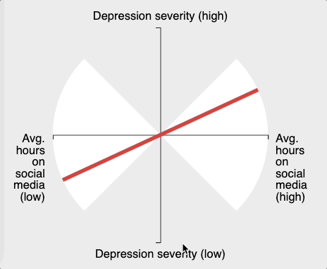
Study Design
STUDY DESIGN
Notes:
First, we had a background survey including
Age
Education level
Etc.

Slide 29
Study Design
STUDY DESIGN
Incongruent
Notes:
First, we had a background survey including
Age
Education level
Etc.

Slide 30



DATASET STATISTICS
Evidence
The supporting data was shown using 50 data points in a scatterplot.
No Contextual Information
Only variable names were introduced without contextual information.
Incongruent Evidence
Scatterplot data was generated uniquely to be incongruent to prior beliefs.
Immigrant Population x Crime Rate
Social Media Hours x Depression Rate
Years of Education x Income
Notes:
Those three datasets included
Immigrant population x crime rate
Social media hours x depression
Years of education x income
We showed them data in the form of a scatterplot with 50 points
We didn’t give any contextual information about the data (e.g., we didn’t tell them any specific immigrant population or geographic location or period in time)
We showed the evidence systematically as incongruent with the prior belief – so this data was artificially generated for each participant to show a trend in the opposite direction of their belief – to maximize the likelihood that we might be able to observe movement in belief.

Slide 31

Study Design
Participant Background Survey
STUDY DESIGN
Notes:
First, we had a background survey including
Age
Education level
Etc.

Slide 32
Study Design
‘Line+Cone’
Training
STUDY DESIGN
Notes:
Next, we trained them on the Line+Cone technique for eliciting their beliefs about correlations
To ensure everyone had a reasonably equal starting point of statistical literacy
They couldn’t advance until they answered a series of statistical comprehension questions correctly.

Slide 33
Study Design
Eliciting Belief
Prior
STUDY DESIGN
Prior
Notes:
Next, we elicited their prior beliefs about a dataset (for example education x income)
Then showed them new data
Elicited their posterior belief
Then added a distracting task for 5 minutes (playing tetris)
Elicited posterior belief once more
We repeated this three times for three different datasets.

Slide 34
Study Design
Eliciting Belief
Data
STUDY DESIGN
Prior
Data
(incongruent)
Notes:
Next, we elicited their prior beliefs about a dataset (for example education x income)
Then showed them new data
Elicited their posterior belief
Then added a distracting task for 5 minutes (playing tetris)
Elicited posterior belief once more
We repeated this three times for three different datasets.

Slide 35
Study Design
Eliciting Belief
Posterior
STUDY DESIGN
Prior
Data
(incongruent)
Posterior
Notes:
Next, we elicited their prior beliefs about a dataset (for example education x income)
Then showed them new data
Elicited their posterior belief
Then added a distracting task for 5 minutes (playing tetris)
Elicited posterior belief once more
We repeated this three times for three different datasets.

Slide 36
Study Design
Eliciting Belief
Distraction
STUDY DESIGN
Prior
Data
(incongruent)
Posterior
Notes:
Next, we elicited their prior beliefs about a dataset (for example education x income)
Then showed them new data
Elicited their posterior belief
Then added a distracting task for 5 minutes (playing tetris)
Elicited posterior belief once more
We repeated this three times for three different datasets.

Slide 37
Study Design
Eliciting Belief
Posterior (T₅)
STUDY DESIGN
Prior
Data
(incongruent)
Posterior
Notes:
Next, we elicited their prior beliefs about a dataset (for example education x income)
Then showed them new data
Elicited their posterior belief
Then added a distracting task for 5 minutes (playing tetris)
Elicited posterior belief once more
We repeated this three times for three different datasets.

Slide 38
Study Design
Eliciting Belief
Repeat (per dataset)
STUDY DESIGN
X 3 (for each dataset)
Prior
Data
(incongruent)
Posterior
Notes:
Next, we elicited their prior beliefs about a dataset (for example education x income)
Then showed them new data
Elicited their posterior belief
Then added a distracting task for 5 minutes (playing tetris)
Elicited posterior belief once more
We repeated this three times for three different datasets.

Slide 39
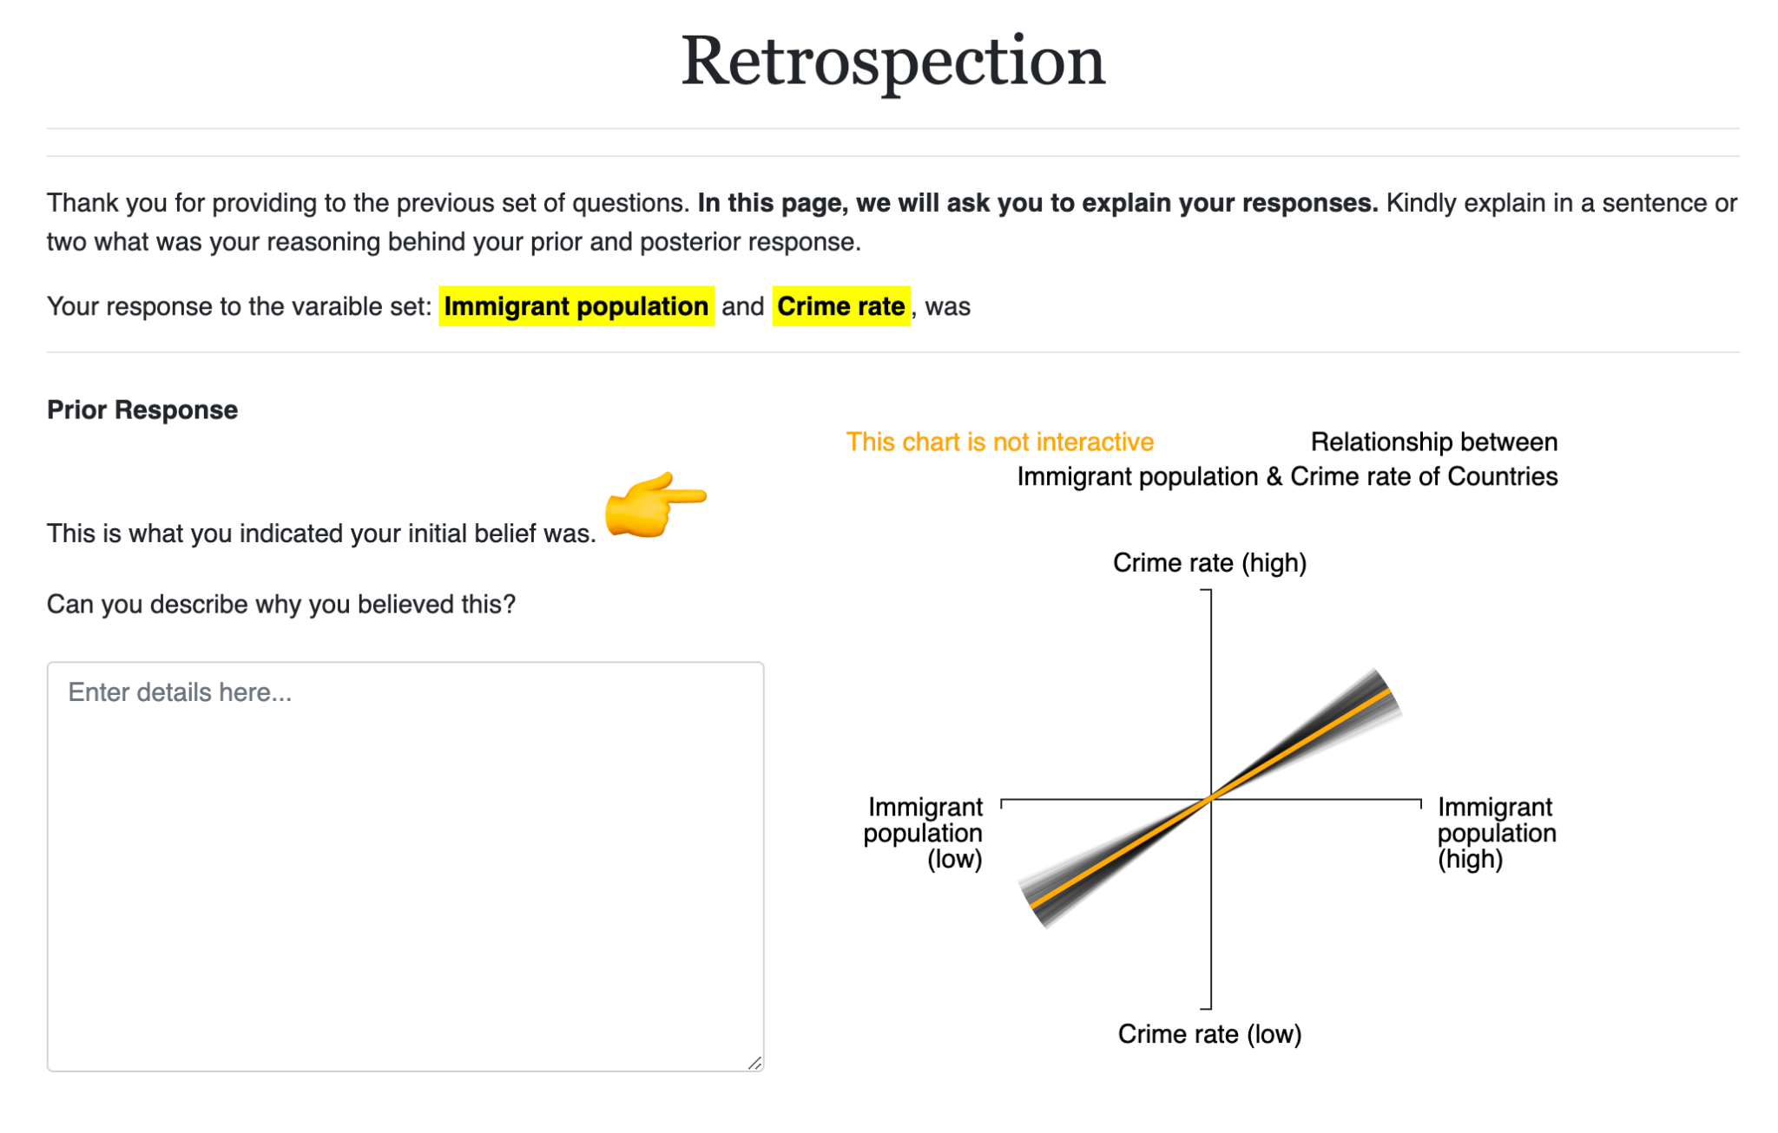

Study Design
Retrospective Analysis
STUDY DESIGN
X 3 (for each dataset)
Prior
Data
(incongruent)
Posterior
Notes:
Next, we elicited their prior beliefs about a dataset (for example education x income)
Then showed them new data
Elicited their posterior belief
Then added a distracting task for 5 minutes (playing tetris)
Elicited posterior belief once more
We repeated this three times for three different datasets.

Slide 40
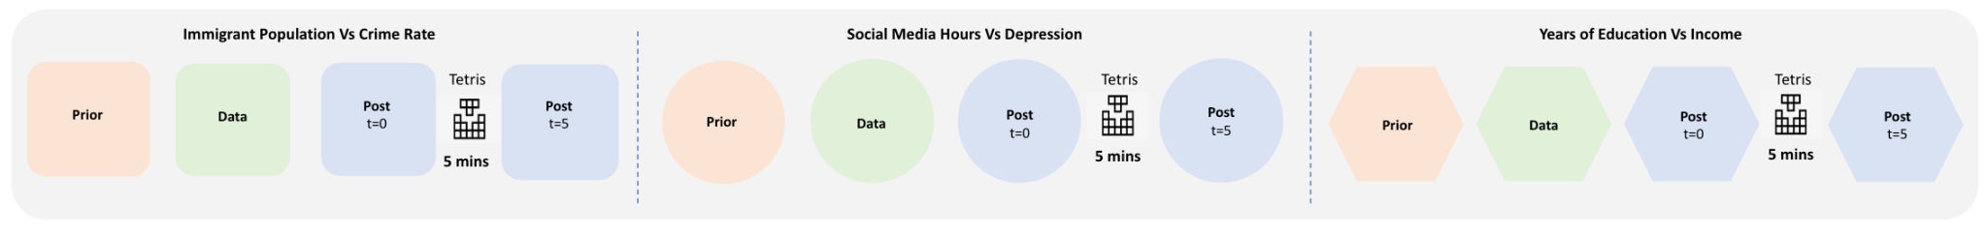
Study Design
Eliciting Belief
STUDY DESIGN
Notes:
Next, we elicited their prior beliefs about a dataset (for example education x income)
Then showed them new data
Elicited their posterior belief
Then added a distracting task for 5 minutes (playing tetris)
Elicited posterior belief once more
We repeated this three times for three different datasets.

Slide 41
Study Design
Retrospective Analysis
METHODOLOGY
Notes:
Afterwards, we asked users to reflect on those beliefs
We showed them the correlations they gave us, and asked them why

Slide 42





PARTICIPANT STATISTICS
Participants
101 participants using Prolific platform.
Background
18+ | Fluent english | From United States
Gender
Male: 49 | Female: 51 | Other: 1
Age
Age range from 18 to 79
Education
Education range from high-school to doctorate
Notes:
We recruited 101 participants through the crowdsourcing platform Prolific
They were all 18+ years of age, fluent in English and located in the US
We tried to balance gender of participants as best we could and recruit from a broad range of demographic ages and education levels

Slide 43
ANALYSIS
We analyzed participant data to identify if there were statistically significant signs of belief ‘decay’.
We also qualitatively analyzed participant responses for hidden trends.
Notes:
Now let me talk through our analysis of these results
We looked for statistically significant signs of belief decay
And conducted qualitative analysis of participant responses to understand the reasons why participants beliefs changed over time

Slide 44
ANALYSIS
We analyzed participant data to identify if there were statistically significant signs of belief ‘decay’.
We also qualitatively analyzed participant responses for hidden trends.
Analysis 1
Quantitative Analysis
Notes:
Starting with our quantitative analysis

Slide 45
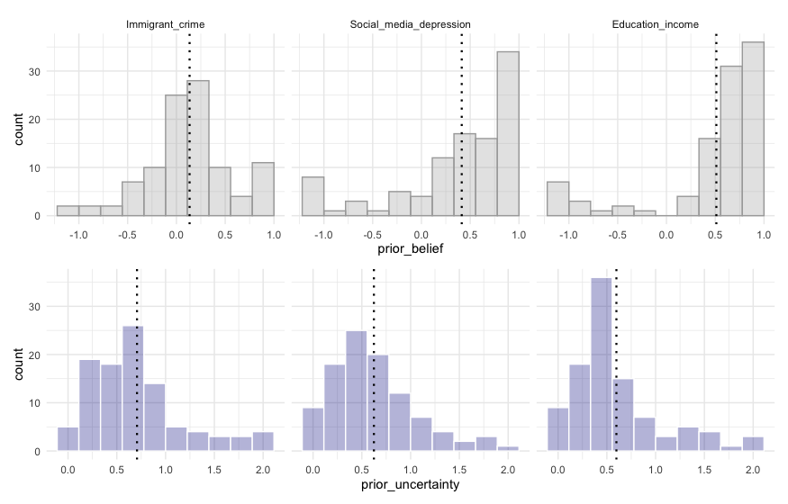
Observing Priors
Prior Beliefs
Trends of participants' prior beliefs for the 3 datasets were widely diverging.
QUANTITATIVE ANALYSIS
Notes:
The prior beliefs for the three datasets were all quite different
These distributions show the distribution of all participants’ beliefs for each of the three datasets starting with immigrant population x crime rate on the left, social media hours x depression in the middle, and education level x income on the right

Slide 46
Observing Priors
Prior Beliefs
Trends of participants' prior beliefs for the 3 datasets were widely diverging.
Prior Uncertainty
Trends of participants' posterior beliefs for the 3 datasets were widely diverging.
QUANTITATIVE ANALYSIS
Notes:
The prior beliefs for the three datasets were all quite different
These distributions show the distribution of all participants’ beliefs for each of the three datasets starting with immigrant population x crime rate on the left, social media hours x depression in the middle, and education level x income on the right

Slide 47
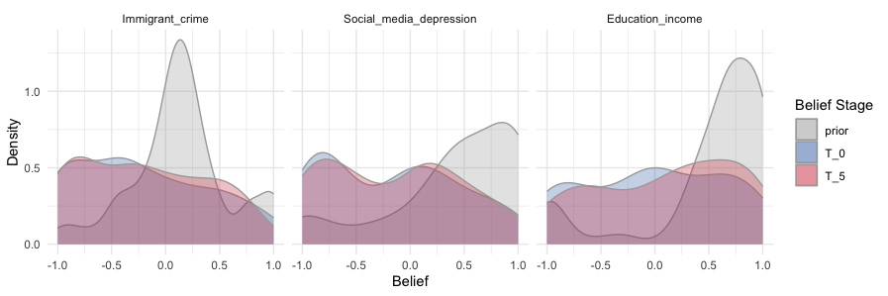
Observing Posteriors
Posterior Beliefs
Belief decay is observed with small marginal shifts for prior, T0 and T5 beliefs.
QUANTITATIVE ANALYSIS
Notes:
Now if we compare those curves, shown here in gray, and remembering that participants were shown incongruent data, their posterior belief is shown here in blue, so we see a pretty big shift. Participants did respond to the evidence that we showed them.
Now, after they played tetris, again remembering that they saw no new information during that time period, we elicited their beliefs again shown here in red. We can see a slight shift back towards the direction of the prior in some parts of the distribution

Slide 48
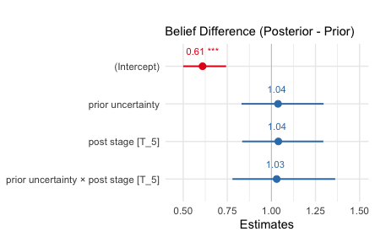
Statistical Findings
Mixed-effects
Regression
Testing Hypothesis 1:
For (Posterior(t) - Prior), no significant difference observed between T_5 and T_0 (β = 0.038 [-0.181 0.258], z = 0.344, p=0.731).
Testing Hypothesis 2:
For prior uncertainty (β = 0.029 [-0.249, 0.308], z = 0.208, p=0.835) on the difference between participants' elicited posterior (at T_0 and T_5) and prior beliefs, no significant effect observed.
QUANTITATIVE ANALYSIS
Notes:
But, after running a mixed-effects regression model
We found no statistically significant results to suggest that there was movement towards the prior
And no statistically significant results to suggest that uncertainty was higher over time for the strongly held beliefs.

Slide 49
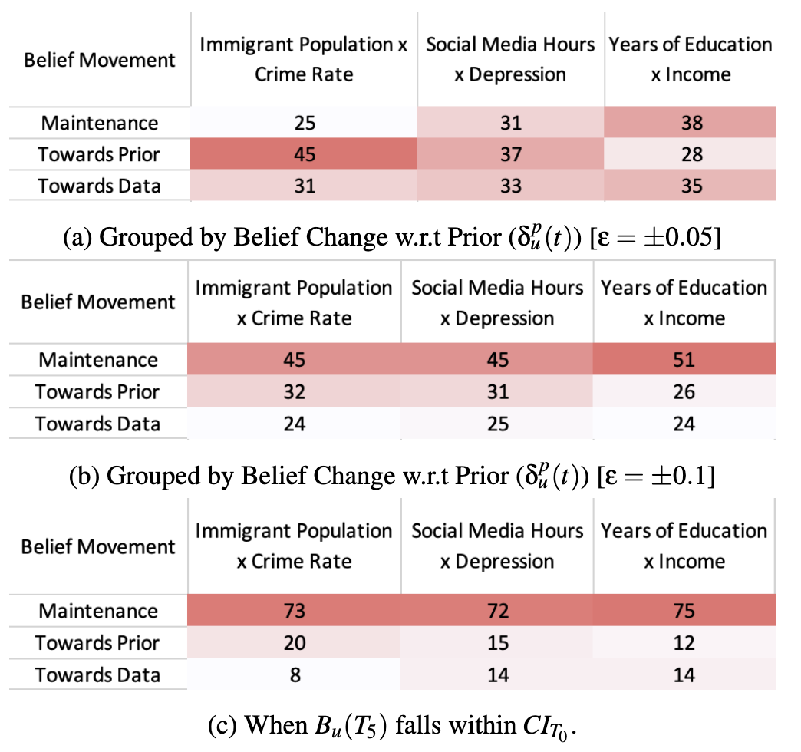
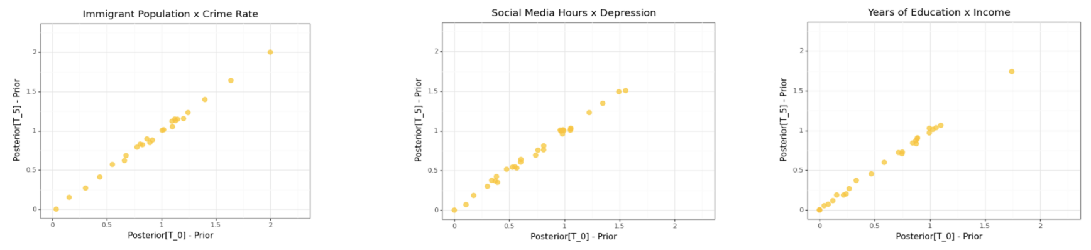
Statistical Findings
Belief Trend
Threshold (ɛ = 0.05)
Most individuals showed movement towards prior (⅔ datasets)
QUANTITATIVE ANALYSIS
Notes:
If we inspect these trends more closely, we can observe how many participants for each dataset maintained their belief, so given some fudge factor of 0.05, we find that 25, 31, and 38 participants respectively maintained their belief – shown in yellow.
We find that 45, 37, and 28 participants respectively showed belief decay or movement towards the prior - shown in blue.
And 31, 33, and 35 participants respectively showed belief strengthening or movement towards the data - shown in purple.

Slide 50
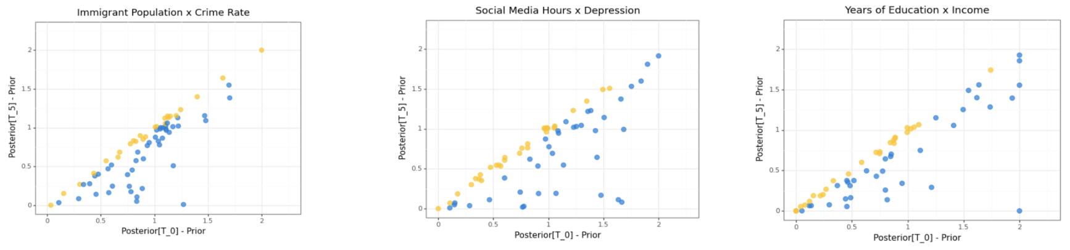
Statistical Findings
Belief Trend
Threshold (ɛ = 0.05)
Most individuals showed movement towards prior (⅔ datasets)
QUANTITATIVE ANALYSIS
Notes:
If we inspect these trends more closely, we can observe how many participants for each dataset maintained their belief, so given some fudge factor of 0.05, we find that 25, 31, and 38 participants respectively maintained their belief – shown in yellow.
We find that 45, 37, and 28 participants respectively showed belief decay or movement towards the prior - shown in blue.
And 31, 33, and 35 participants respectively showed belief strengthening or movement towards the data - shown in purple.

Slide 51
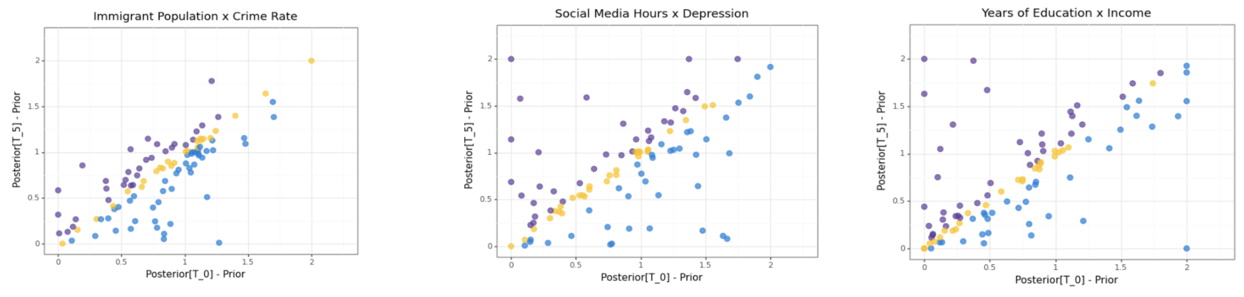
Statistical Findings
Belief Trend
Threshold (ɛ = 0.05)
Most individuals showed movement towards prior (⅔ datasets)
QUANTITATIVE ANALYSIS
Notes:
If we inspect these trends more closely, we can observe how many participants for each dataset maintained their belief, so given some fudge factor of 0.05, we find that 25, 31, and 38 participants respectively maintained their belief – shown in yellow.
We find that 45, 37, and 28 participants respectively showed belief decay or movement towards the prior - shown in blue.
And 31, 33, and 35 participants respectively showed belief strengthening or movement towards the data - shown in purple.

Slide 52
Statistical Findings
Alternative
Formulations
Threshold (ɛ = 0.1):
Most individuals maintained their beliefs (50% more than for
ɛ = 0.05)
T5 is within Uncertainty of T0
Almost 70% responses show belief maintenance.
QUANTITATIVE ANALYSIS
Notes:
But this fudge factor of 0.05 was arbitrary – so we also considered there may be more noise in how we elicit the beliefs, and we considered a fudge factor of 0.1 as well. This led to a much clearer trend that most participants actually maintained their belief.
Alternatively, we also explored another formulation where we considered it belief maintenance as long as the second posterior belief was within the range of uncertainty indicated in the first posterior elicitation. And in this case, we observed even stronger trends of belief maintenance. In all cases, this debunked our hypothesis!

Slide 53
ANALYSIS
We analyzed participant data to identify if there were statistically significant signs of belief ‘decay’.
Findings
We found no evidence to suggest systematic belief decay
We also qualitatively analyzed participant responses for hidden trends.
Analysis 1
Quantitative Analysis
Notes:
So in summary, we found no statistically significant differences to suggest that there is a systematic belief decay happening.

Slide 54
ANALYSIS
We analyzed participant data to identify if there were statistically significant signs of belief ‘decay’.
We also qualitatively analyzed participant responses for hidden trends.
Analysis 2
Qualitative Analysis
Notes:
Now, in spite of not seeing any systematic trends of belief decay, we were curious to see that, in cases where we do observe belief decay, why does it happen?

Slide 55
ANALYSIS
We analyzed participant data to observe statistically significant signs of belief ‘decay’.
We also analyzed participant responses for hidden trends.
Analysis 2
Qualitative Analysis
Methodology
Participants were asked to reflect on their responses.
Notes:
So we asked participants why for each prior and posterior elicitation they gave us.

Slide 56
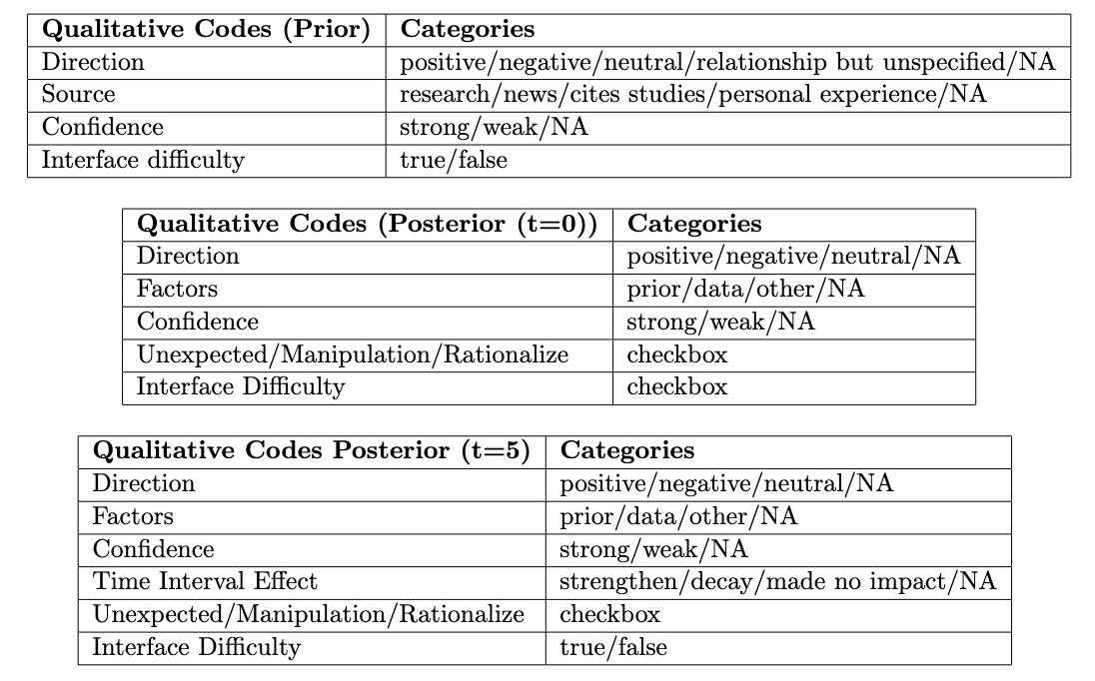
ANALYSIS
We analyzed participant data to observe statistically significant signs of belief ‘decay’.
We also analyzed participant responses for hidden trends.
Analysis 2
Qualitative Analysis
Methodology
Codebook was established to identify participants' rationale
Notes:
And we conducted qualitative coding of this data where all authors independently identified trends then came together to discuss until a stable code book was obtained

Slide 57
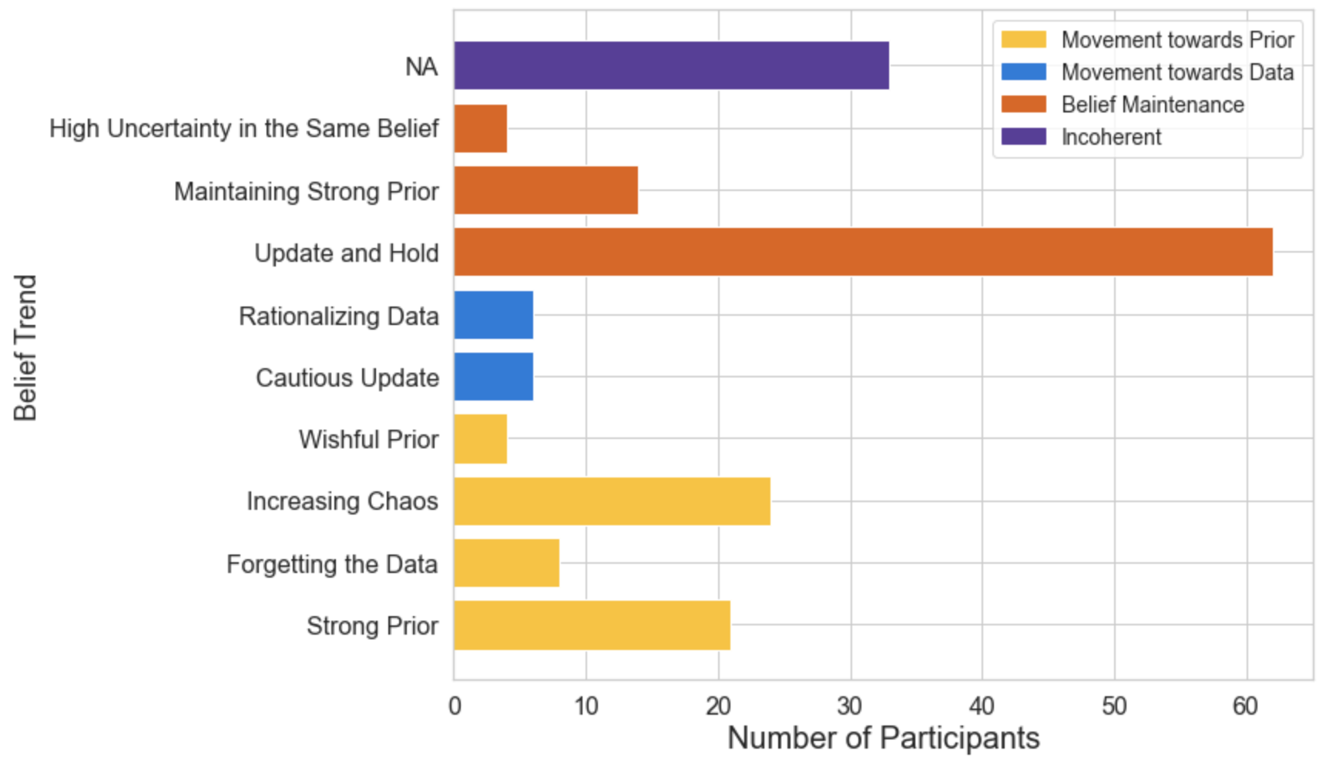
9 Prototypical Themes
Observed using participant’s retrospective responses
Towards Prior
QUALITATIVE ANALYSIS
Strong Prior Participants resort back to prior beliefs after the Tetris task. Quote: “I felt even more confident in my previous answer the more I thought about it, and felt it might even be more positively correlated than before.”
Forgetting the Data Participants forgot the data shown during the Tetris task. Quote: “I couldn't remember my response after viewing the data on the scatter plot so I defaulted to my original belief it seems.”
Increased Chaos Participants increased their uncertainty over time. Quote: “That still doesn't make sense to me because why would more people earn less for more education?? so I decided to increase the chaos factor.”
Wishful Prior Participants expressed regret to not resort to their prior beliefs. Quote: “I went along with the data, but I shouldn't have. I think it was a mistake to change from my first graph.”
Notes:
We identified a total of 9 prototypical trends.
4 of them were reasons why participants exhibited belief decay, or movement towards the prior.
First, …
Second, …
Third, …
Fourth, …

Slide 58
9 Prototypical Themes
Observed using participant’s retrospective responses
Towards Data
QUALITATIVE ANALYSIS
Cautious Update Participants updated their beliefs with increased uncertainty. Quote: “I think I was able to change my mind as I was not quite sure of the relationship between these events.”
Rationalizing the Data Participants updated their beliefs with increased confidence Quote: “I believe that the data concluded that the more hours spent on social media, the less likely one is to have depression, and I was sure of it after the game.”
Notes:
Next, there were two reasons why participants cited belief movement towards the data
First, …
Second, …

Slide 59
9 Prototypical Themes
Observed using participant’s retrospective responses
Maintenance
QUALITATIVE ANALYSIS
Update and Hold Participants held their updated beliefs throughout the study Quote: “I updated my belief based on the scatterplot I was shown.”
Maintaining Strong Prior Participants discarded the data shown and maintained their prior belief throughout the study. Quote: “I decided to stick with my initial belief because I had a feeling that I was correct, but I wasn't 100% sure.”
High Uncertainty in the Same Belief Participants maintained updated beliefs with high uncertainty throughout the study. Quote: “According to the data there is a strong negative correlation but I do not believe this so I left a wide range of error.”
Notes:
Finally, there were three reasons why participants cited belief maintenance
First, …
Second, …
Third, …

Slide 60
9 Prototypical Themes
Observed using participant’s retrospective responses
Incoherent Responses
QUALITATIVE ANALYSIS
Notes:
However, we note that there were a number of incoherent responses…
Out of 303 responses for 3 datasets from 101 participants, 56 of those responses were not able to be successfully transcribed.

Slide 61
ANALYSIS
We analyzed participant data to identify if there were statistically significant signs of belief ‘decay’.
Findings
| No global trends observed for belief decay
| 9 themes observed for belief movement
We also qualitatively analyzed participant responses for hidden trends.
Analysis 2
Qualitative Analysis
Notes:
So in summary, we do not find that participants globally exhibit this trend of belief decay, but when it does happen, we now have a better understanding of the underlying mechanisms for why

Slide 62



DISCUSSION
Mimicking Beliefs
Individuals may have simply mimicked the data shown without impacting their true beliefs.
Ambiguous Belief Movement
Noisy qualitative encoding can generate inaccurate belief movement trends.
‘Factual’ Retrospection
Discrepancy b/w actual beliefs v. perceived beliefs by participants in retrospection.

Slide 63



FUTURE WORK
Extended Time Intervals
Larger durations (days/weeks/months) should be tested for belief persistence.
Varying Visualizations
Diverse visualization for both eliciting beliefs and providing evidence should be tested.
‘Real’ Evidence
Real data with contextual information rather than synthetic incongruent data.

Slide 64
CONCLUSION
We hypothesized that individuals would experience belief decay over time.
We analyzed the belief movement over time for individuals in response to new information presented.
The quantitative analysis found no statistically significant evidence to support our hypothesis.
The qualitative analysis revealed 9 belief movement trends.
This work fills a gap in prior work by beginning to scrutinize assumptions made in belief update studies.

